Slide 1
The Transport Layer
Chapter 6

Slide 2
The Transport Service
Services Provided to the Upper Layers
Transport Service Primitives
Berkeley Sockets

Slide 3
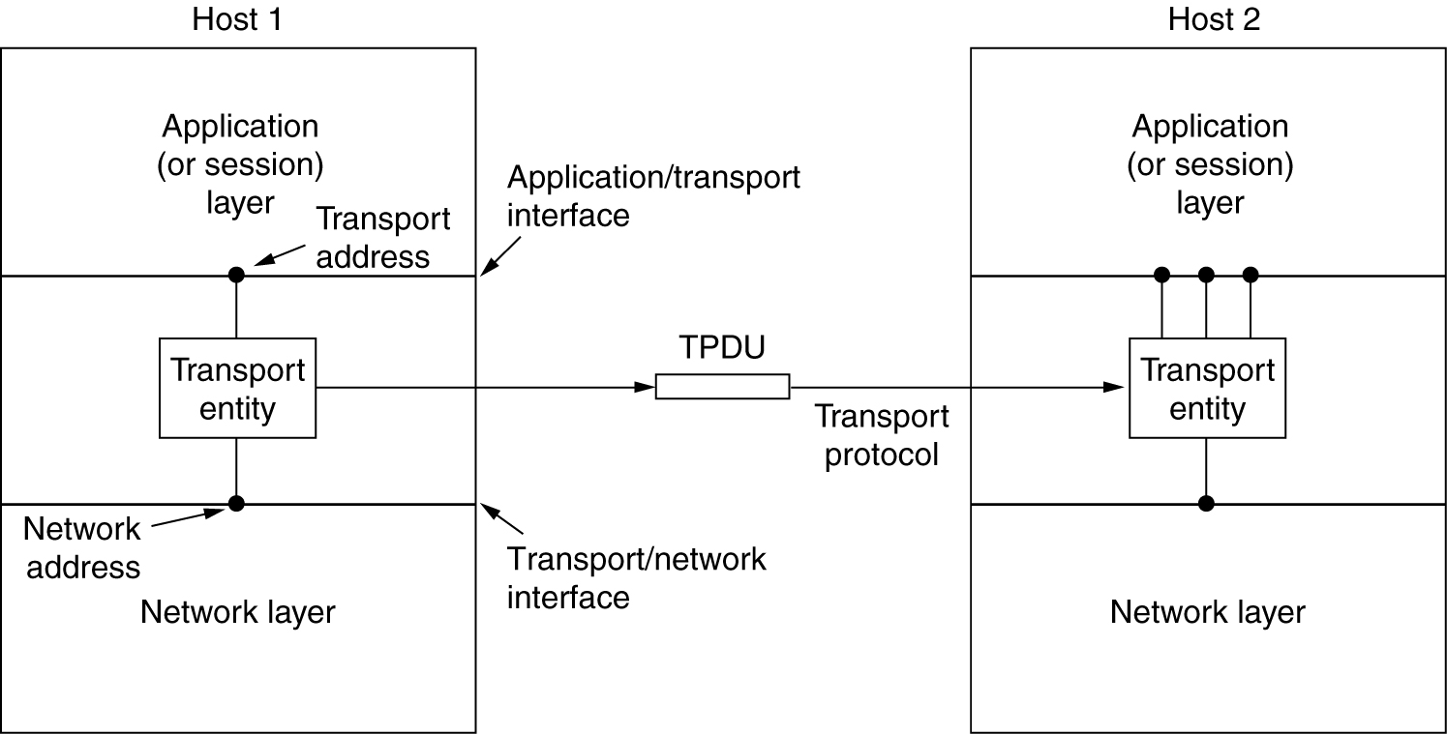
Services Provided to the Upper Layers
The network, transport, and application layers.

Slide 4
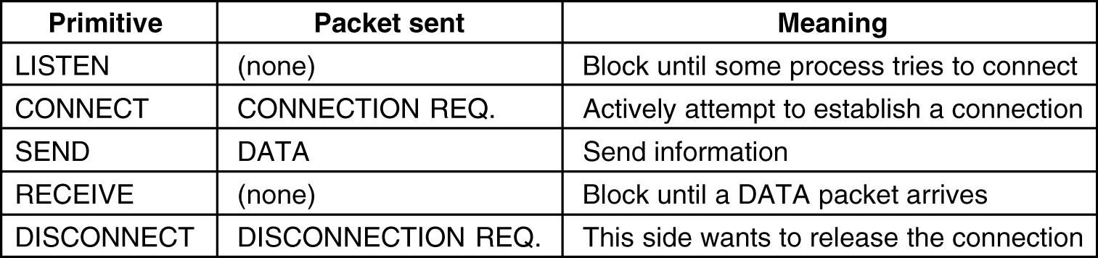
Transport Service Primitives
The primitives for a simple transport service.

Slide 5
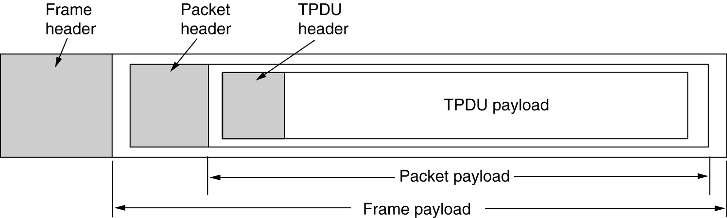
Transport Service Primitives (2)
Frame trailer
The nesting of TPDUs, packets, and frames.

Slide 6
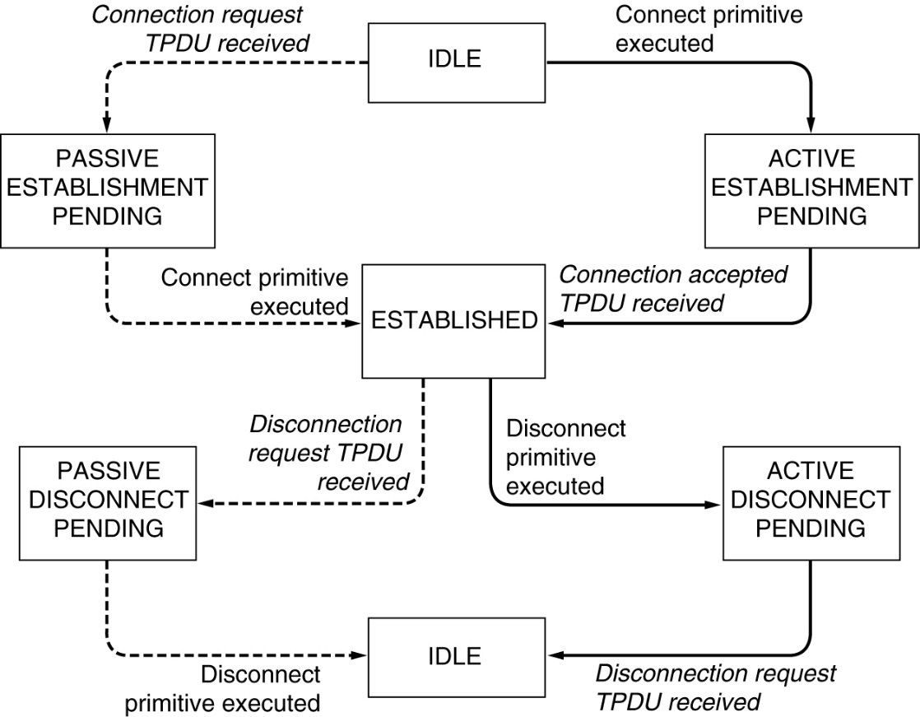
Transport Service Primitives (3)
A state diagram for a simple connection management scheme. Transitions labeled in italics are caused by packet arrivals. The solid lines show the client's state sequence. The dashed lines show the server's state sequence.

Slide 7
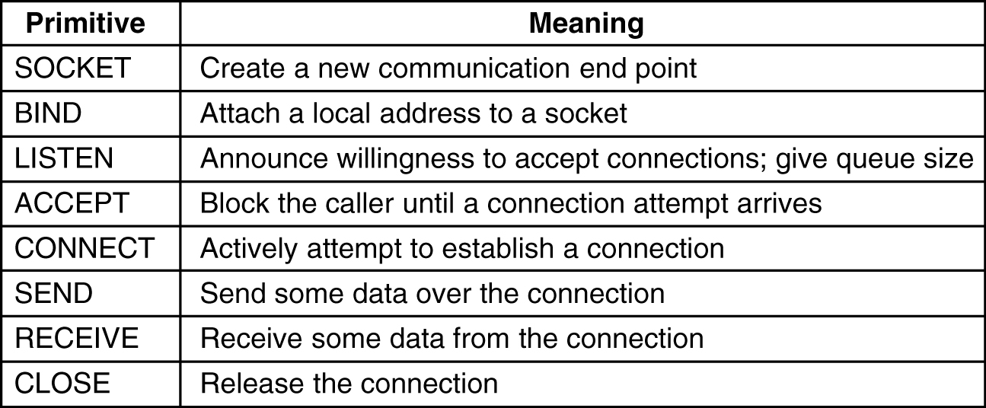
Berkeley Sockets
The socket primitives for TCP.

Slide 8
Elements of Transport Protocols
Addressing
Connection Establishment
Connection Release

Slide 9
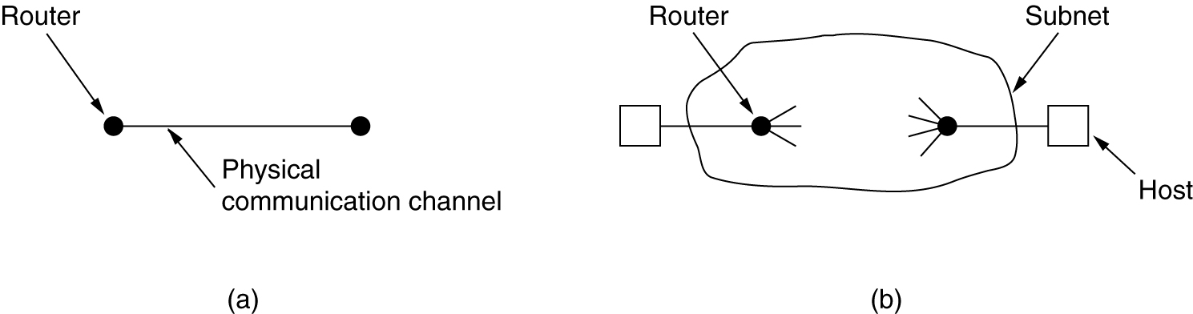
Transport Protocol
(a) Environment of the data link layer.
(b) Environment of the transport layer.

Slide 10
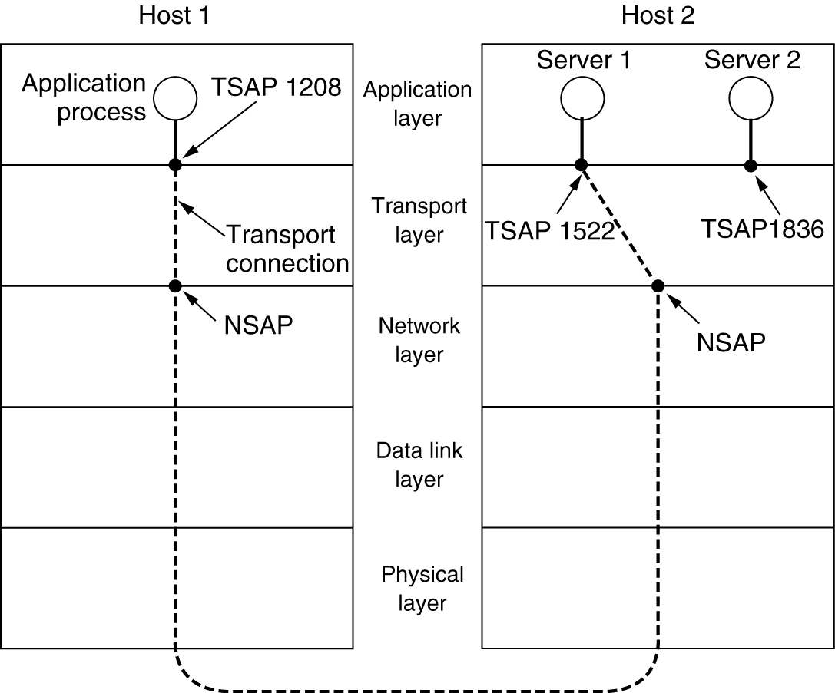
Addressing
TSAPs, NSAPs and transport connections.

Slide 11
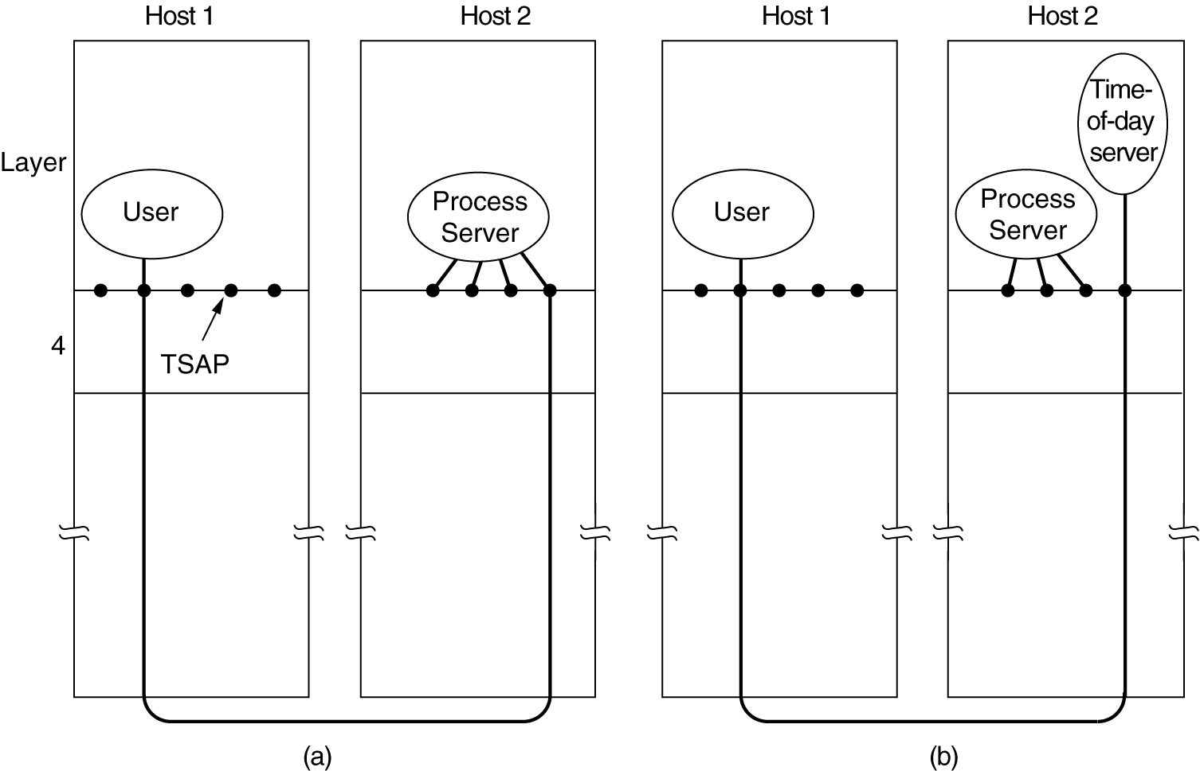
Connection Establishment
How a user process in host 1 establishes a connection with a time-of-day server in host 2.

Slide 12
The Internet Transport Protocols: UDP
Introduction to UDP

Slide 13
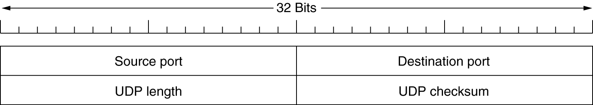
Introduction to UDP
The UDP header.

Slide 14
The Internet Transport Protocols: TCP
Introduction to TCP
The TCP Service Model
The TCP Protocol
The TCP Segment Header
TCP Connection Establishment
TCP Connection Release

Slide 15
The TCP Service Model
Port
Protocol
Use
21
FTP
File transfer
23
Telnet
Remote login
25
SMTP
E-mail
69
TFTP
Trivial File Transfer Protocol
79
Finger
Lookup info about a user
80
HTTP
World Wide Web
110
POP-3
Remote e-mail access
119
NNTP
USENET news
Some assigned ports.

Slide 16
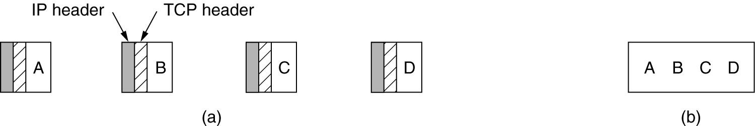
The TCP Service Model (2)
(a) Four 512-byte segments sent as separate IP datagrams.
(b) The 2048 bytes of data delivered to the application in a single READ CALL.

Slide 17
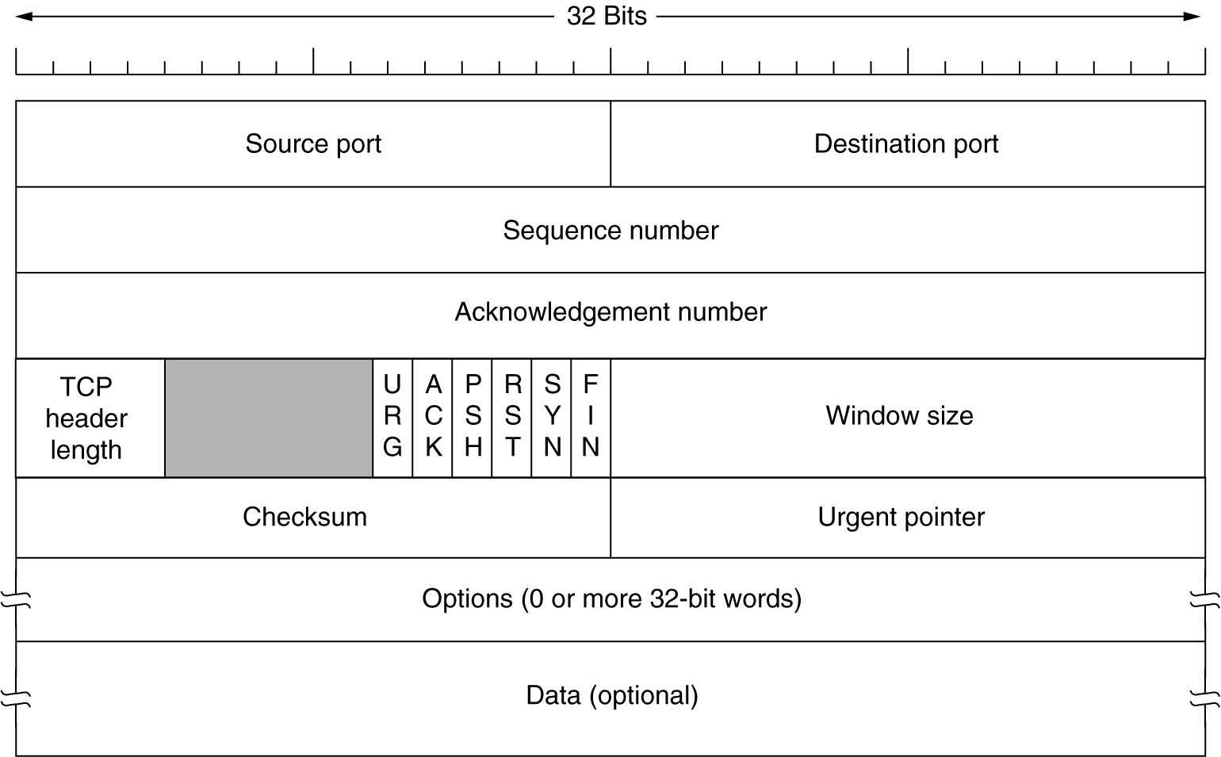
The TCP Segment Header
TCP Header.

Slide 18
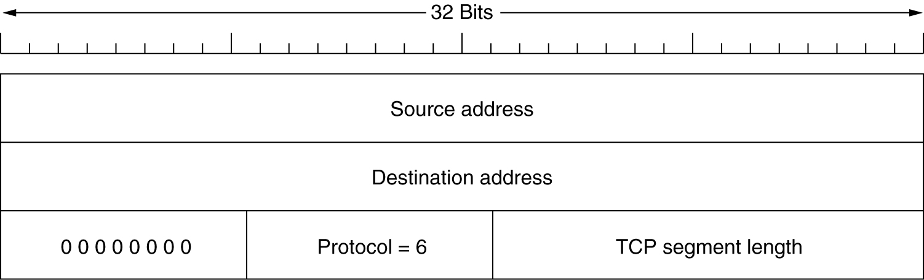
The TCP Segment Header (2)
The pseudoheader included in the TCP checksum.

Slide 19
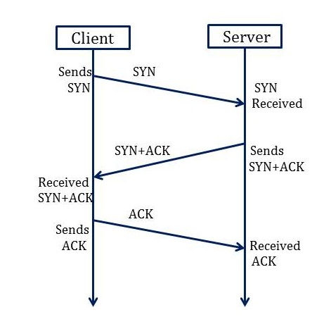
Connection Establishment in TCP
Transmission Control Protocol (TCP) provides a secure and reliable connection between two devices using the 3-way handshake process.
3-Way Handshake Connection Establishment Process Diagram:

Slide 20
Client to Server
Synchronization Sequence Number (SYN) − The client sends the SYN to the server
When the client wants to connect to the server, then it sends the message to the server by setting the SYN flag as 1.
The message carries some additional information like the sequence number (32-bit random number), say 500
The ACK is set to 0.
The maximum segment size and the window size are also set. For example, if the window size is 1000 bits and the maximum segment size is 100 bits, then a maximum of 10 data segments can be transmitted by Server in the connection by dividing (1000/100=10).

Slide 21
Server to Client
Synchronization and Acknowledgement (SYN-ACK) to Synchronization Sequence Number (SYN) and Acknowledgement Number − The server sends the SYN and Ack to the Client
The server will set the SYN flag to '1' and send it to the client if the server also wants to establish the connection.
The sequence number used for SYN will be a random 32 bit number different from the client's SYN. Say 1000
The server also advertises its window size and maximum segment size to the client. The server window size must be less than the client. Suppose the server shows window size = 500 bits and maximum segment size = 50 bits then the client can send maximum 10 segments (500/50) to server
The server acknowledges the client request by setting the ACK flag to 1.
Acknowledgement number is the Client SYN Sequence number +1
For example, if the client has sent the SYN with sequence number = 500, then the server will send the Acknowledgment number = 501
The ACK indicates the response of the segment it received and SYN indicates with what sequence number it will start the segments.

Slide 22
Client to Server
Acknowledgment (ACK) to the server
The client sends the acknowledgment (ACK) to the server after receiving the synchronization (SYN + ACK) from the server by setting ACK flag as 1
The Acknowledgement number as Server SYN sequence number +1
For example, if the Server has sent the SYN with sequence number = 1000, then the client will send the Acknowledgment number = 1001
After getting the (ACK) from the client, the connection is established between the client and the server.
Now the data can be transmitted between the client and server sides.

Slide 23
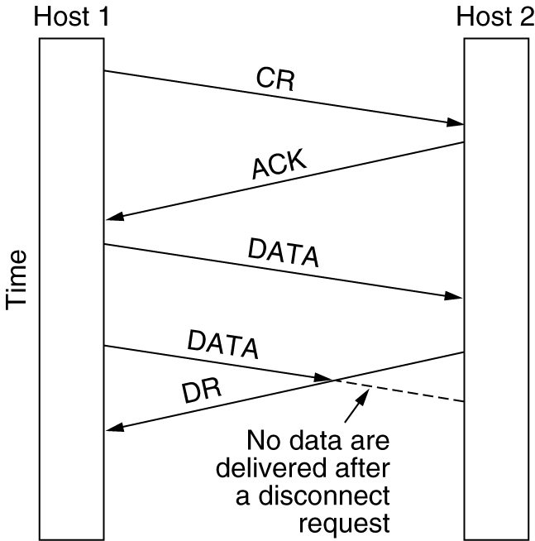
Connection Release
Abrupt disconnection with loss of data.

Slide 24
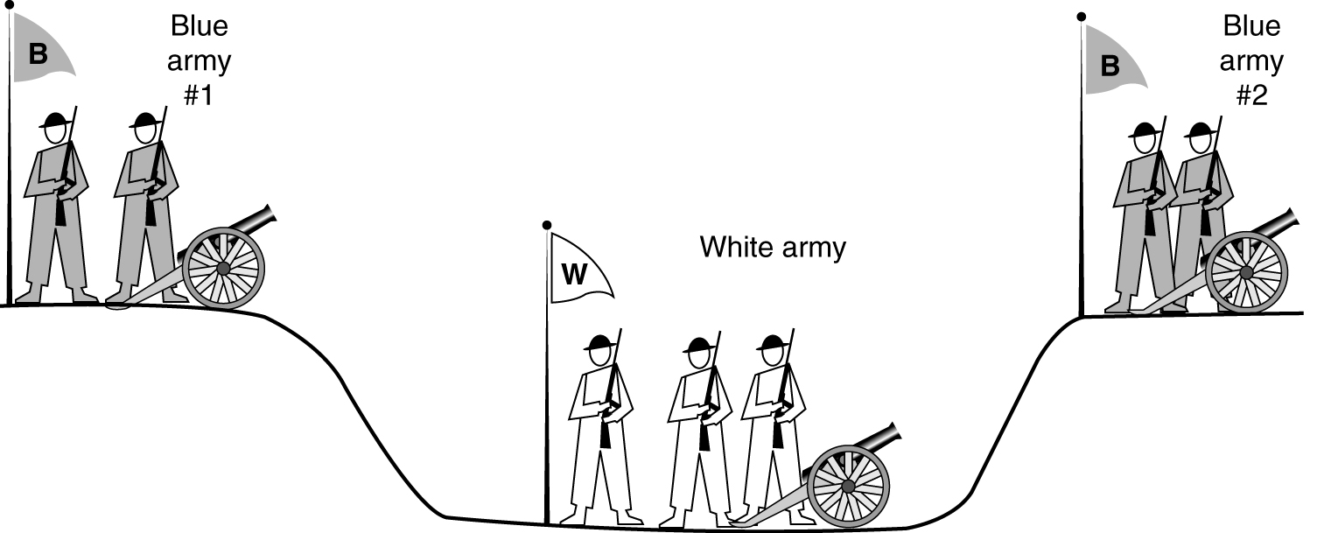
Connection Release (2)
The two-army problem.

Slide 25
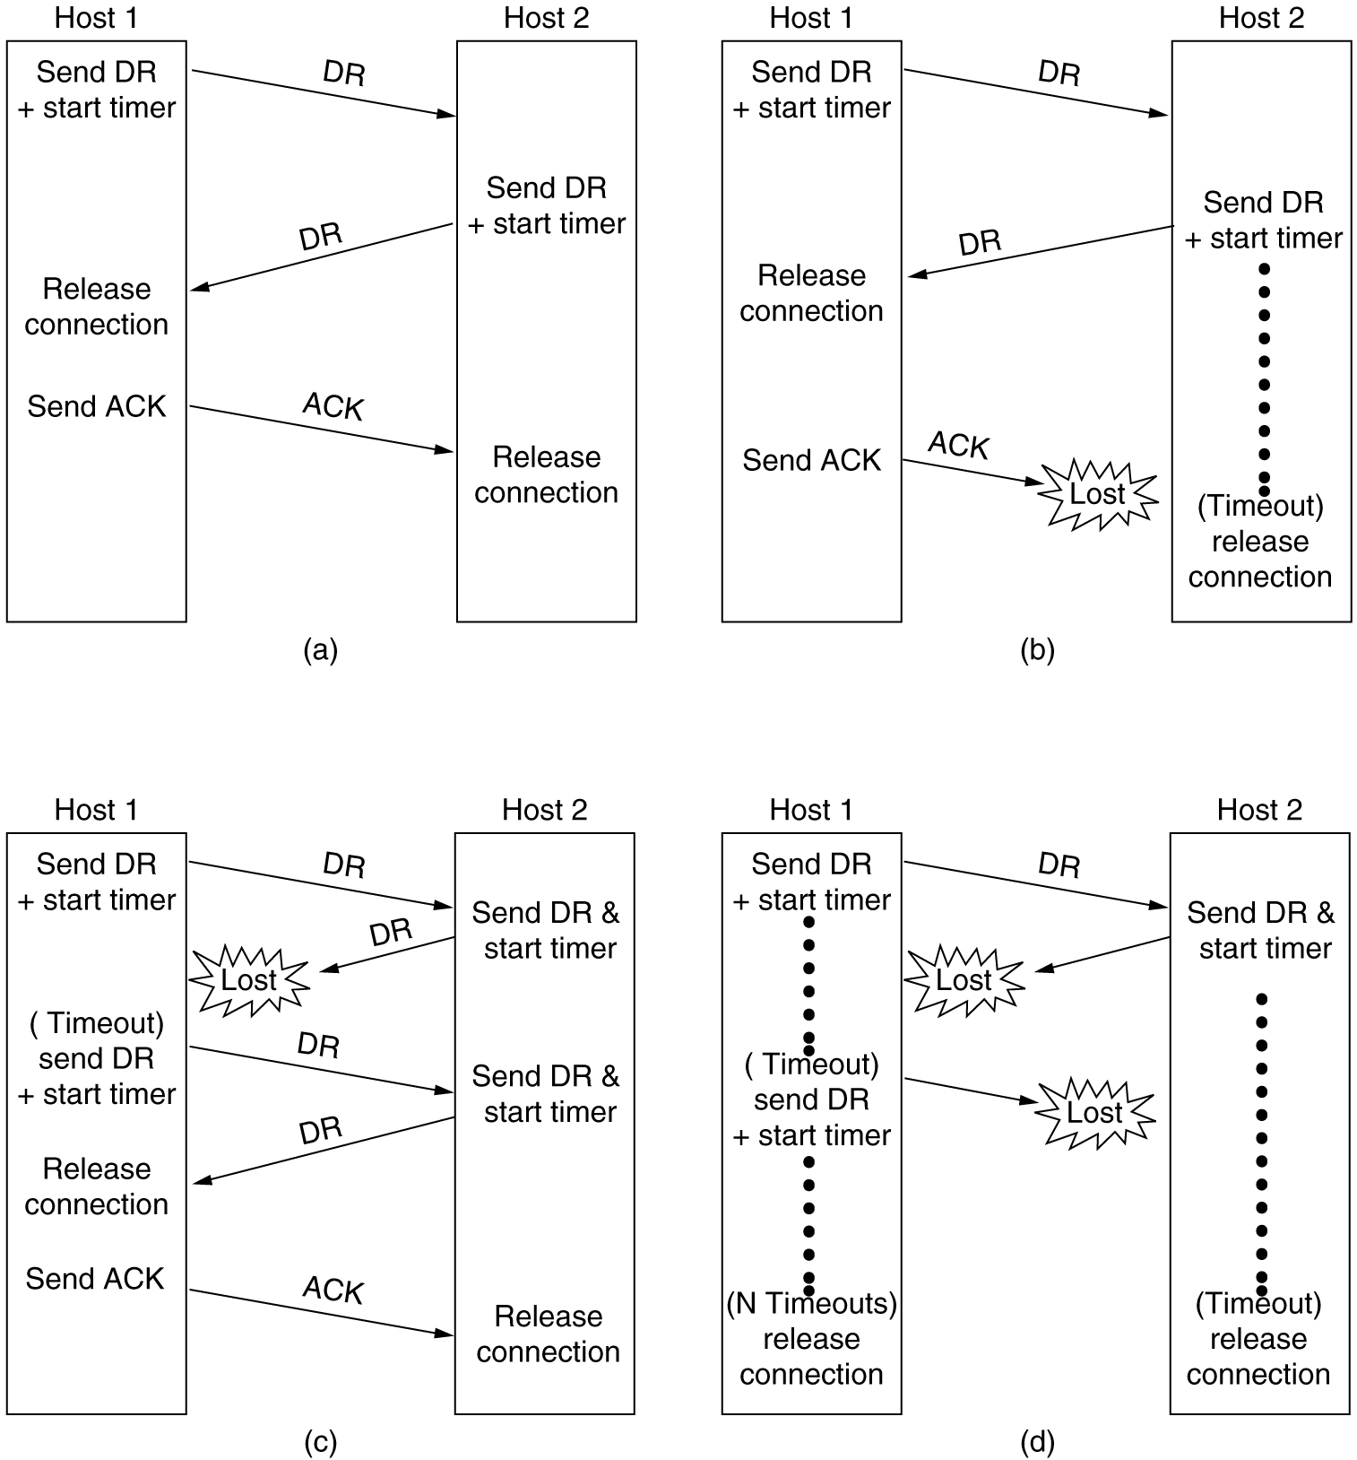
Connection Release (3)
6-14, a, b
Four protocol scenarios for releasing a connection. (a) Normal case of a three-way handshake. (b) final ACK lost.

Slide 26
Connection Release (4)
6-14, c,d
(c) Response lost. (d) Response lost and subsequent DRs lost.

Slide 27
The Application Layer

Slide 28
DNS – The Domain Name System
The DNS Name Space
Resource Records
Name Servers

Slide 29
DNS
DNS is the invention of a hierarchical, domain-based naming scheme and a distributed database system for implementing the naming scheme.
DNS is used to map a name onto an IP address, an application program calls a library procedure called the Resolver, passing it the name as a parameter.
The Resolver sends a UDP packet to a local DNS server, which then looks up the name and returns IP address, the program can then establish a TCP connection with the destination or send it UDP packets.

Slide 30
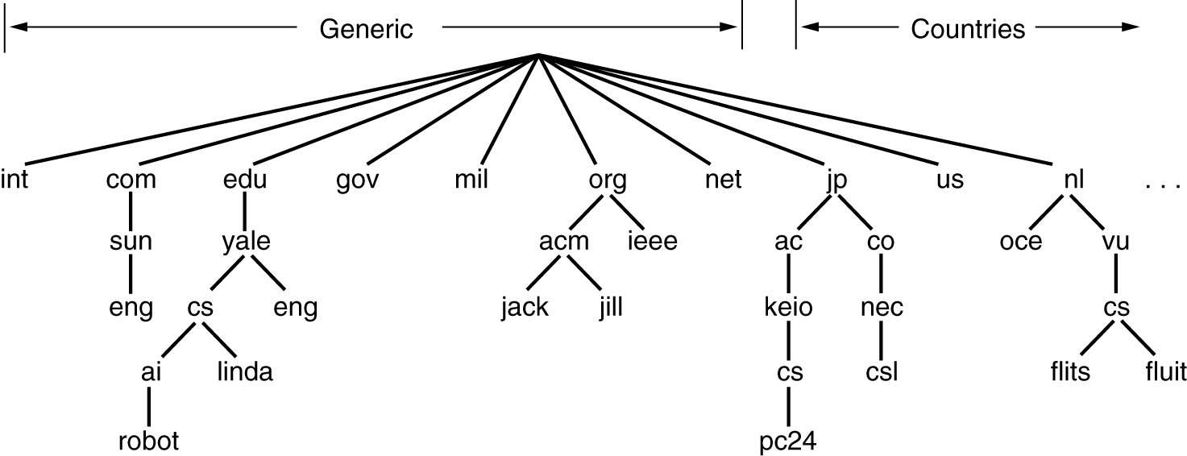
The DNS Name Space
A portion of the Internet domain name space.

Slide 31
DNS Name Space
Internet is divided into 200 top-level domains, where each domain covers many hosts.
Each domain is partitioned into subdomains, and these are further partitioned, and so on.
Top-level domains : Generic
Countries.
Generic Domains were com(commercial), edu(educational institutions), gov, int(international organizations), mil, net(network providers), and org(non profit organization).
The Country domains include one entry for every country.
Each domain is named by the path upward from it to the (unnamed) root.

Slide 32
DNS(contd..)
Domain names can be either absolute or relative.
An absolute domain name always ends with a period (e.g.,eng.sun.com)
Relative does not.
Domain names are case insensitive.
Domains can be inserted into the tree in two different ways.
Each domain controls how it allocates the domains under it.
To create a new domain, permission is required of the domain in which it will be included. So that name conflicts are avoided.
Once domain has been created & registered, it can create subdomains, without getting permission from anybody higher up the tree.

Slide 33
Resource Records
Every Domain, whether it is a single host or a top-level domain, can have a set of resource records associated with it.
For single host, the most common resource record is just its IP address, but many other kinds of resource records also exist.
When a resolver gives a domain name to DNS, it gets back resource records associated with that name. Thus, the primary function of DNS is to map domain names onto resource records.
A resource record is a five-tuple. The format is as follows:
Domain_name Time_to_live Class Type Value
Domain_name :tells the domain to which this record applies
Time_to_live field gives an indication of how stable the record is.
Class: For Internet information, it is always IN
For non-Internet information, other codes can be used.

Slide 34
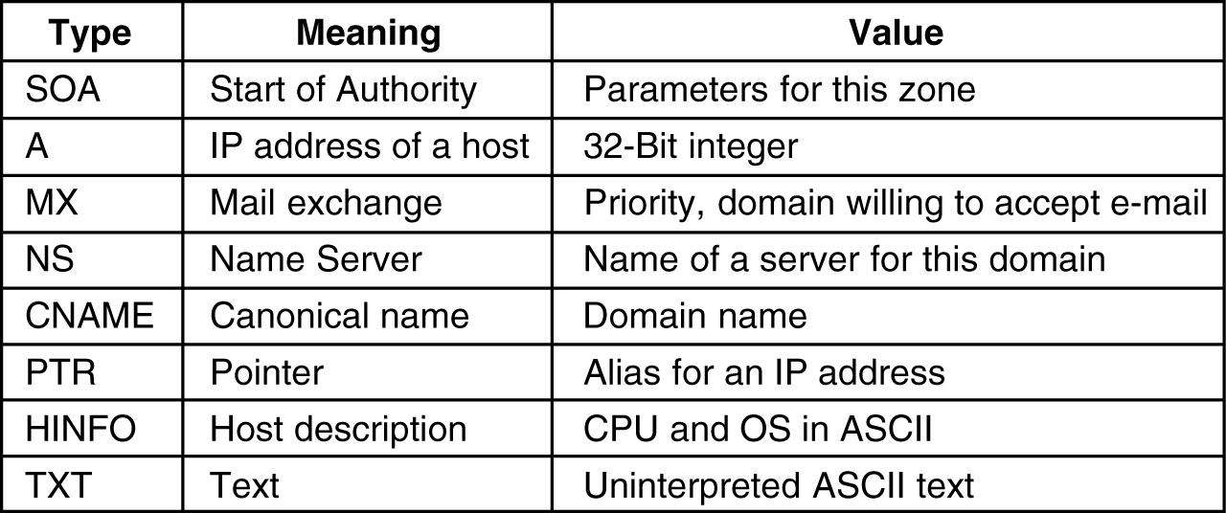
Resource Records
Type: This field tells what kind of record this is. The important types are listed below
The principal DNS resource records types.
Value: This can be a number, a domain name, or an ASCII string.

Slide 35
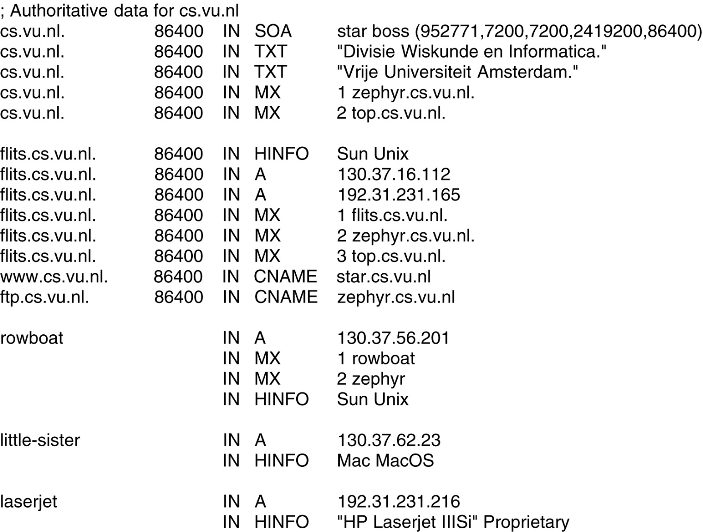
Resource Records (2)
A portion of a possible DNS database for cs.vu.nl.

Slide 36
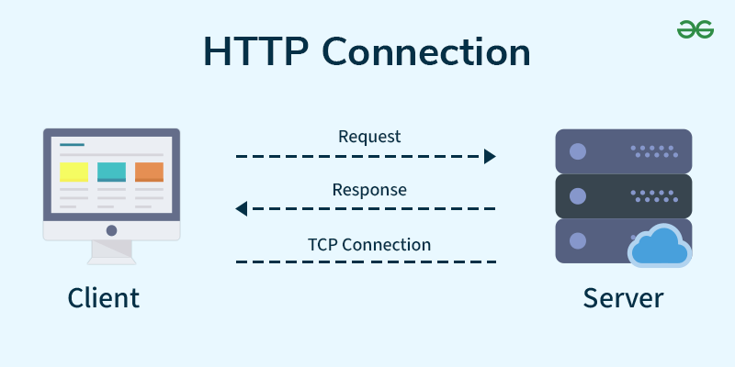
HTTP (HyperText Transfer Protocol
HTTP stands for Hypertext Transfer Protocol, and it’s the system that allows communication between web browsers (like Google Chrome or Firefox) and websites. When you visit a website, your browser uses HTTP to send a request to the server hosting that site, and the server sends back the data needed to display the page.
HTTP is a set of rules that lets your browser and web server communicate, ensuring websites load correctly.
HTTP uses the services of TCP on well-known port 80

Slide 37
How HTTP Works: Step-by-Step Process
1.Open Web Browser: First, you open your web browser and type a website URL (e.g., www.example.com).
DNS Lookup: Your browser asks a Domain Name System (DNS) server to find out the IP address associated with that URL. Think of this as looking up the phone number of the website.
Send HTTP Request: Once the browser has the website’s IP address, it sends an HTTP request to the server. The request asks the server for the resources needed to display the page (like text, images, and videos).
Server Response: The server processes your request and sends back an HTTP response. This response contains the requested resources (like HTML, CSS, JavaScript) needed to load the page.
Rendering the Web Page: Your browser receives the data from the server and displays the webpage on your screen.
Note:After the page is loaded, the connection between the browser and server is closed. If you request a new page, a new connection will be made.

Slide 38
HTTP Request
An HTTP request is how your browser asks the server for something. It includes:
HTTP Version: The version of HTTP (like HTTP/1.1 or HTTP/2) being used.
URL: The specific address of the Website (e.g., https://www.example.com/about).
HTTP Method: The type of action being requested (e.g., GET to retrieve information or POST to send data).
HTTP Request Headers: Extra information about the request, like what kind of browser you're using or what kind of content you’re expecting.
HTTP Request Body: In some cases, the request will include a body that contains data (e.g., when you submit a form).

Slide 39
HTTP Response
An HTTP response is the server’s answer to your request. It includes:
HTTP Status Code: A number that tells you if the request was successful or not (e.g., 200 OK means everything is fine, 404 Not Found means the requested page doesn’t exist).
Response Headers: Information about the response, like what kind of data is being sent (e.g., Content-Type: text/html means it’s an HTML page).
Response Body: The content that the server sends back (e.g., HTML code that the browser will use to display the webpage).

Slide 40
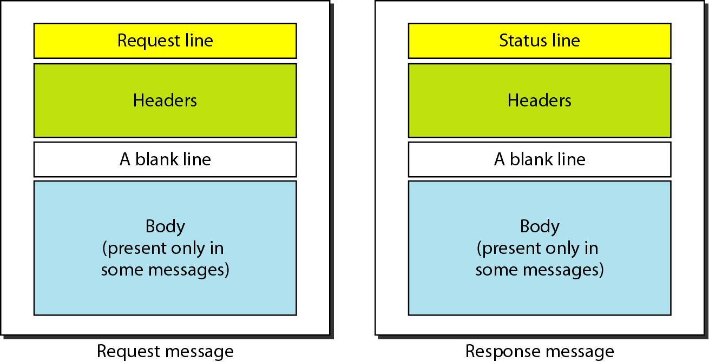
HTTP Request and Response Message
Computer Networks
27-<number>

Slide 41
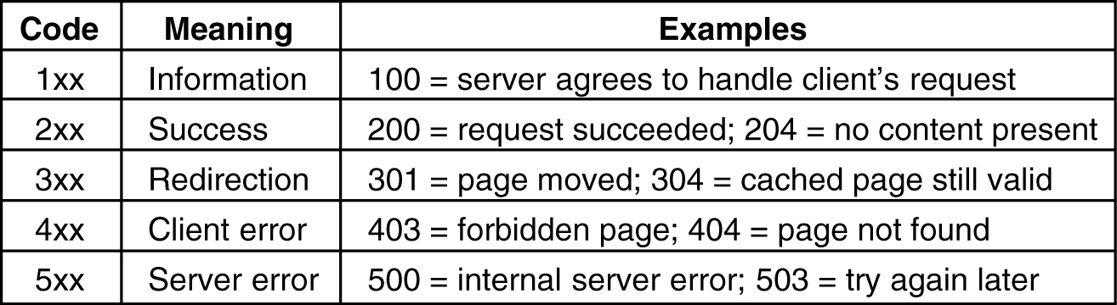
HTTP Status code

Slide 42
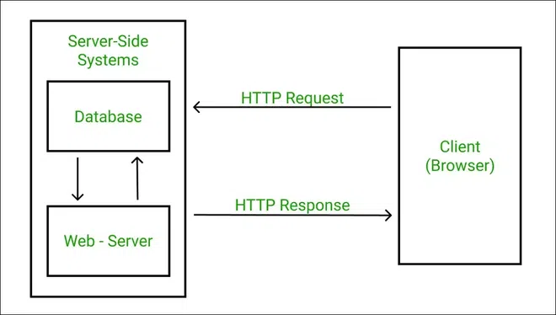
HTTP Request and Response

Slide 43
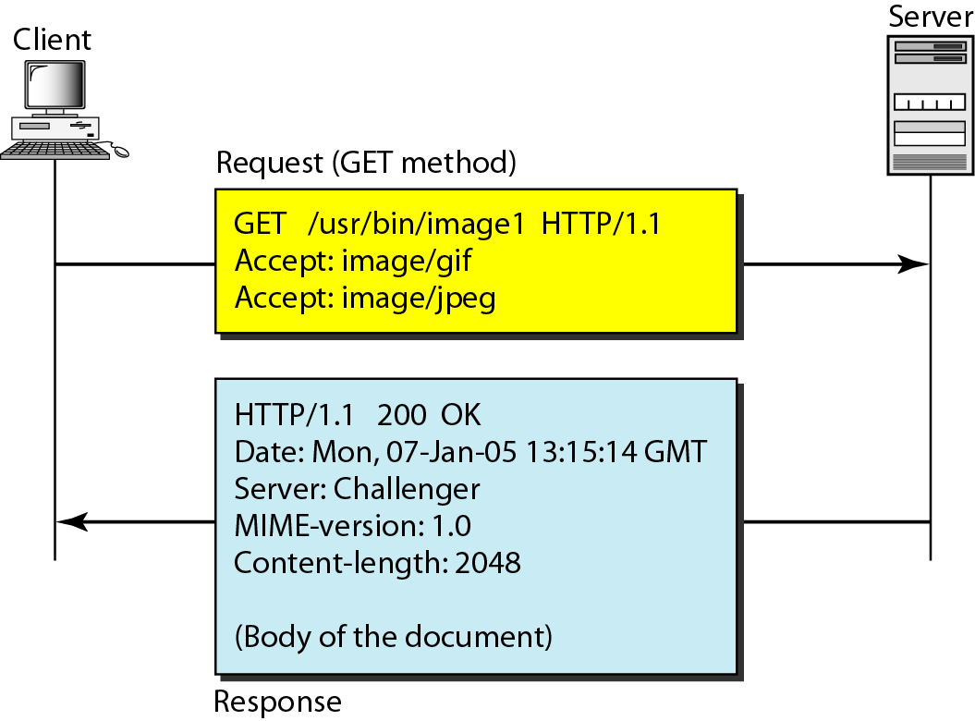
Example 1
Computer Networks
27-<number>

Slide 44
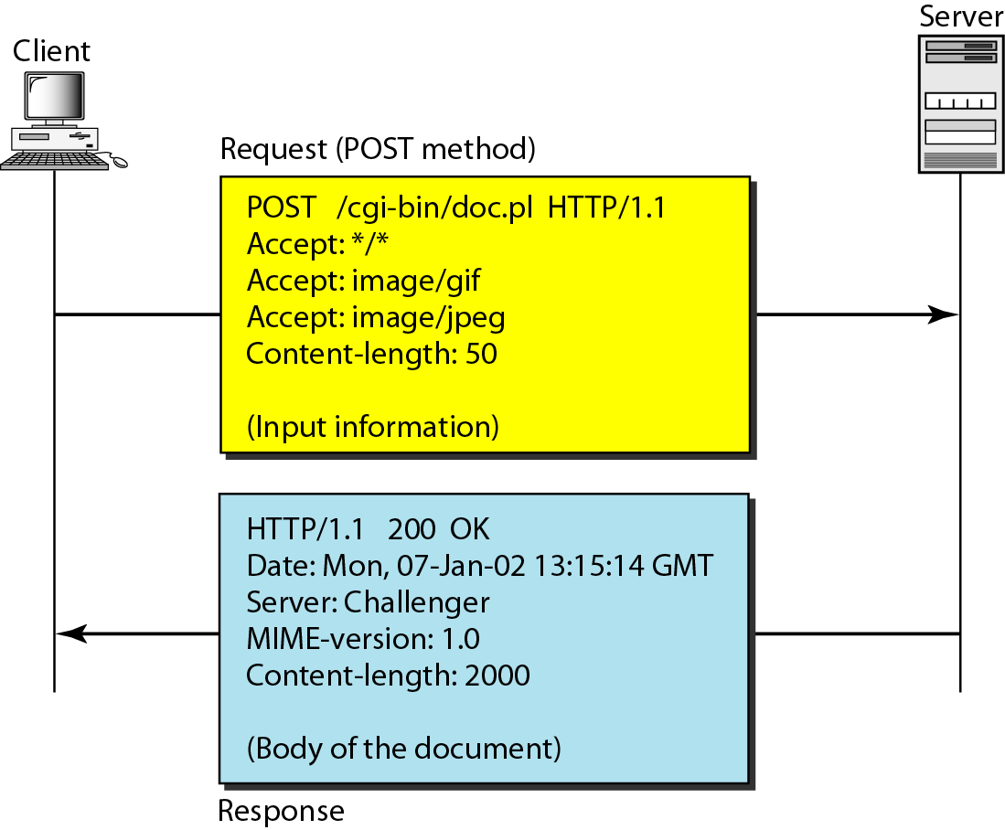
Example 2
Computer Networks
27-<number>

Slide 45
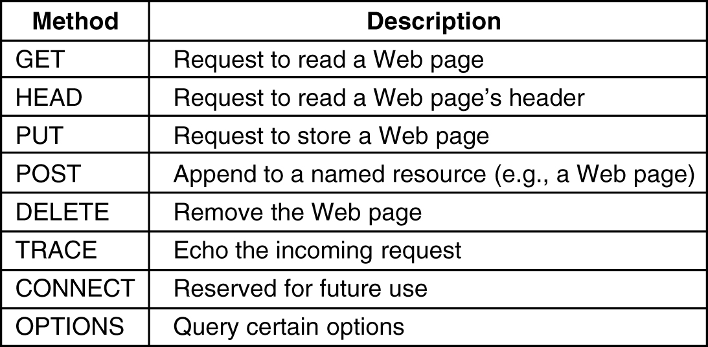
HTTP Methods
The built-in HTTP request methods.

Slide 46
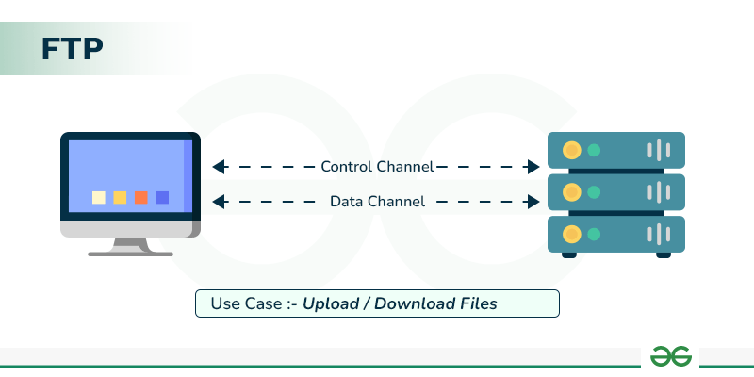
FTP ( File Transfer Protocol )
FTP, or File Transfer Protocol is a standard network protocol
It works by using two separate TCP connections for commands and data, allowing clients to upload, download, and manage files on a remote server. used to transfer files between a client and a server on a network.
The well-known port 21 is used for the control connection, and the well-known port 20 is used for the data connection.

Slide 47
Types of FTP
There are different ways through which a server and a client do a file transfer using FTP. Some of them are mentioned below:
Anonymous FTP: Anonymous FTP is enabled on some sites whose files are available for public access. A user can access these files without having any username or password. Instead, the username is set to anonymous, and the password is to the guest by default. Here, user access is very limited. For example, the user can be allowed to copy the files but not to navigate through directories.
Password Protected FTP: This type of FTP is similar to the previous one, but the change in it is the use of username and password.
FTP Secure (FTPS): It is also called as FTP Secure Sockets Layer (FTP SSL). It is a more secure version of FTP data transfer. Whenever FTP connection is established, Transport Layer Security (TLS) is enabled.
FTP over Explicit SSL/TLS (FTPES): FTPES helps by upgrading FTP Connection from port 21 to an encrypted connection.
Secure FTP (SFTP): SFTP is not a FTP Protocol, but it is a subset of Secure Shell Protocol, as it works on port 22.

Slide 48
USES of FTP
FTP is especially useful for:
Transferring Large Files: FTP can transfer large files in one shot; thus applicable when hosting websites, backing up servers, or sharing files in large quantities.
Remote File Management: Files on a remote server can be uploaded, downloaded, deleted, renamed, and copied according to the users’ choices.
Automating File Transfers: FTP is a great protocol for the execution of file transfers on predefined scripts and employments.
Accessing Public Files: Anonymous FTP means that everybody irrespective of the identity is allowed to download some files with no permissions needed.

Slide 49
Steps to use FTP
Connect to the FTP Server: One can connect to the server using the address, username and password through an FTP client or a command line interface. Anonymous Information may not need a username and password.
Navigate Directories: Some commands include ls that is used to list directories and cd that is used to change directories.
Transfer Files: File transfer may be done by using the commands such as get for downloading files, and put for uploading files.
Manage Files: Make operations like deletion (Delete), renaming (Rename) as well as copying (Copy) of files.
Close the Connection: Once file transfer has been accomplished, terminate the connection by giving the bye or quit command.

Slide 50
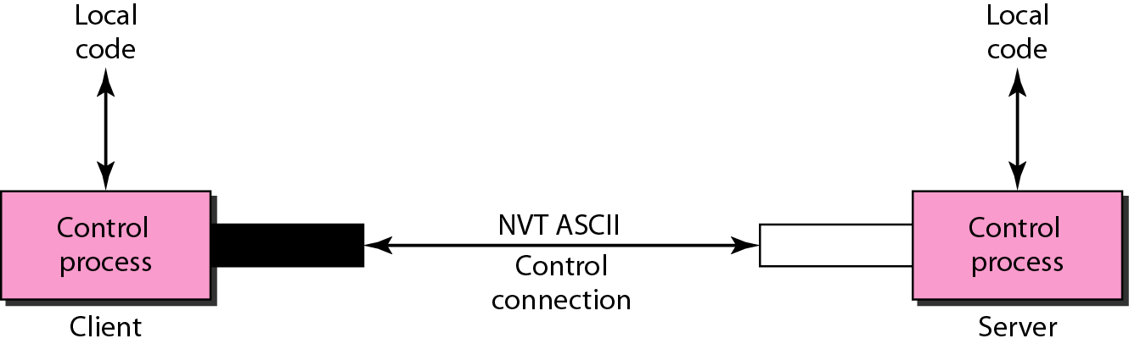
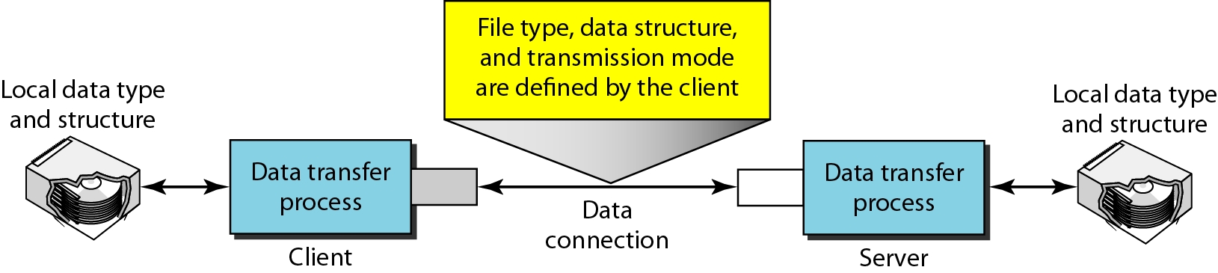
Communication over Two Connections
Computer Networks
26-<number>

Slide 51
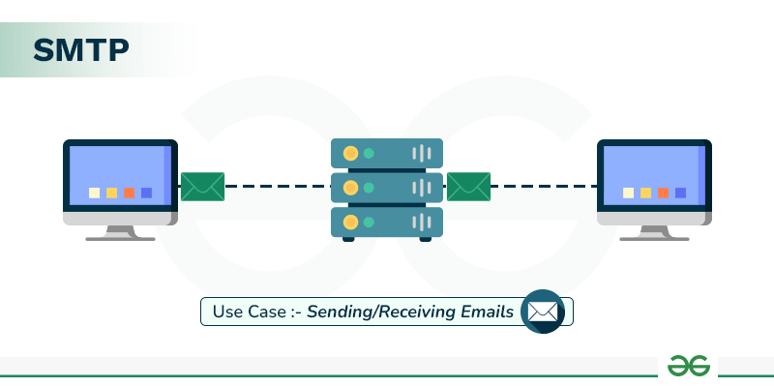
Simple Mail Transfer Protocol (SMTP)
Simple Mail Transfer Protocol (SMTP) is an application layer protocol used for exchanging email messages
It is essential in the email communication process and operates at the application layer of the TCP/IP stack.
To send an email, the client opens a TCP connection to the SMTP server. The server, which is always listening on port 25, initiates the connection as soon as it detects a client. Once the TCP connection is established, the client sends the email across the connection.

Slide 52
Types of SMTP Protocol
The SMTP model supports two types of email delivery methods: end-to-end and store-and-forward.
End-to-end delivery is used between organizations. In this method, the email is sent directly from the sender's SMTP client to the recipient's SMTP server without passing through intermediate servers. the SMTP client waits until the email is successfully copied to the recipient's SMTP server before sending it.
Store-and-forward is used within organizations that have TCP/IP and SMTP-based networks. In this method, the email may pass through several intermediate servers (Message Transfer Agents, or MTAs) before reaching the recipient.
The email might stop at multiple intermediate servers before reaching its destination.
The sender is notified as soon as the email reaches the first server, not the final destination.
SMTP.com is a platform that caters to all email delivery

Slide 53
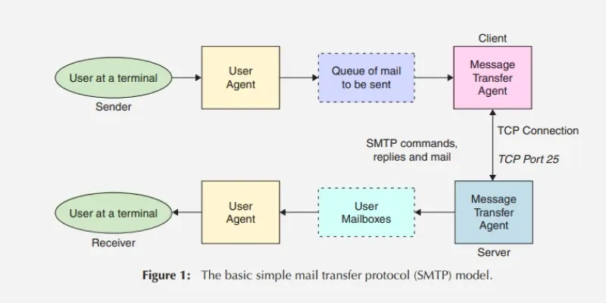
Components and Model of SMTP
Mail User Agent (MUA): It is a computer application (Example: Gmail) that helps you in sending and retrieving mail. It is responsible for creating email messages for transfer to the mail transfer agent(MTA).
Mail Submission Agent (MSA): It is a computer program that receives mail from a Mail User Agent(MUA) and interacts with the Mail Transfer Agent(MTA) for the transfer of the mail.
Mail Transfer Agent (MTA): It is software that has the work to transfer mail from one system to another with the help of SMTP.
Mail Delivery Agent (MDA): A mail Delivery agent or Local Delivery Agent is basically a system that helps in the delivery of mail to the local system.

Slide 54
SMTP Functioning
Three phases of transfer:
● handshaking: Connection establishment
● transfer: direct transfer from sending server (client) to receiving server (server); pushbased: client sends data instead of server
● closure: Connection termination

Slide 55
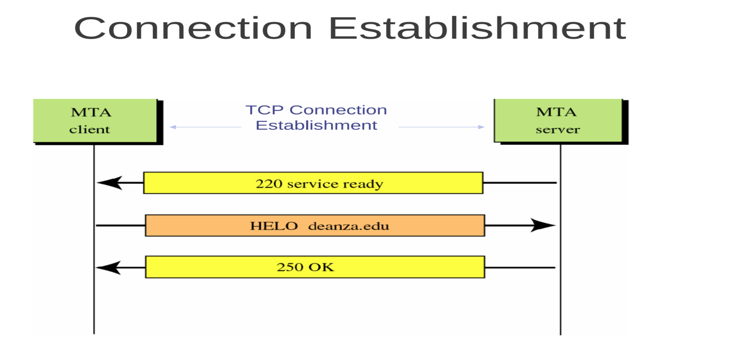
SMTP
SMTP clients and servers have two main components
● User Agents – Prepares the message, encloses it in an envelope.
● Mail Transfer Agent (MTA) – Transfers the mail across the internet
● To send mail, a system must have the client MTA, and to receive mail, a system must have a server MTA
.

Slide 56

Electronic Mail
When both sender and receiver are connected to the mail server via a LAN or a WAN, we need two UAs, two pairs of MTAs and a pair of MAAs. This is the most common situation today.
Computer Networks
26-<number>

Slide 57

User Agent
Services provided by a user agent
Command-driven user agents: mail, pine, and elm.
GUI-based user agents: Eudora, Outlook, and Netscape.
Computer Networks
26-<number>

Slide 58

Format of an E-mail
Computer Networks
26-<number>

Slide 59

Email address
The local port defines the name of a special file, called the user mailbox, where all the mail received for a user is stored for retrieval by the user agent
Computer Networks
26-<number>

Slide 60
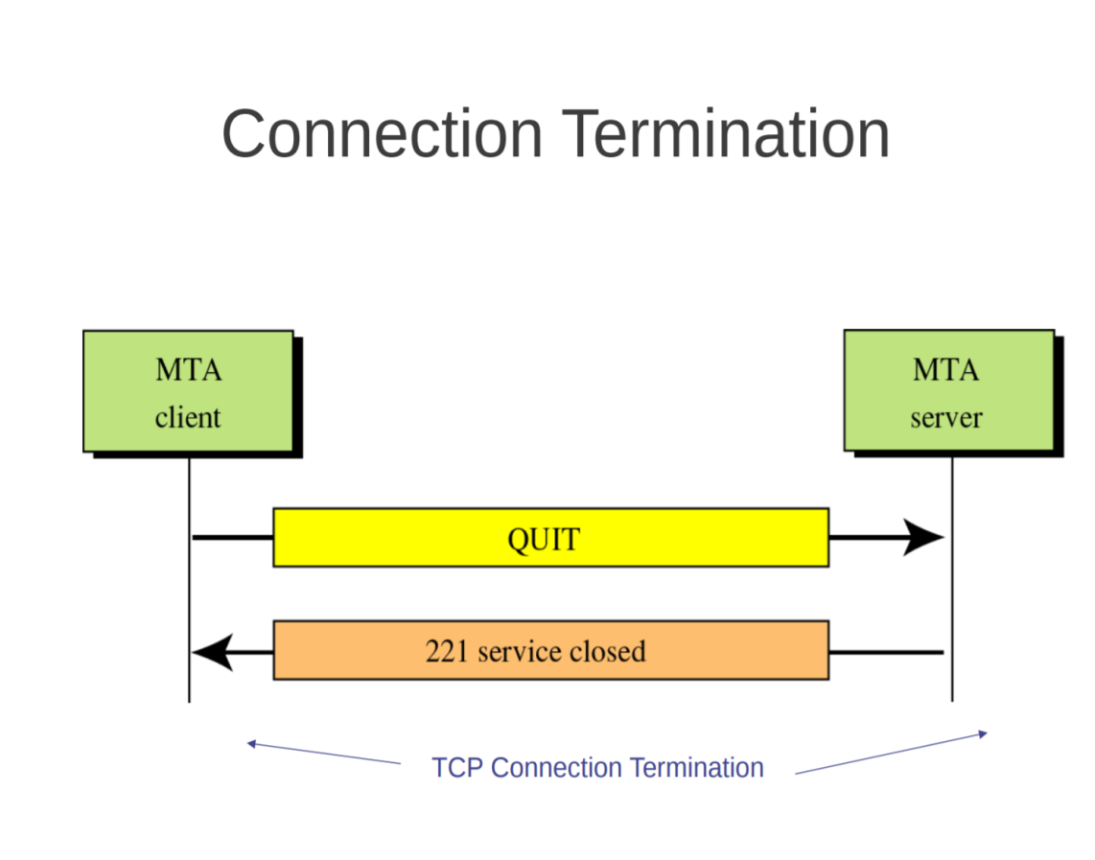
SMTP

Slide 61
World Wide Web
The World Wide Web (WWW) is a system of interconnected public webpages and documents, like text, images, and videos, that are accessible via the internet and linked by hypertext. It was invented by Tim Berners-Lee in 1989
The Web is an application that runs on the Internet and relies on web browsers to view pages using technologies like HTTP.
Key features and components
Hyperlinks: Users navigate between different pages by clicking on links, which can connect documents, images, and other media.
Hypertext Markup Language (HTML): This is the standard markup language used to create web pages.
Hypertext Transfer Protocol (HTTP): This is the protocol used for transferring data over the internet.

Slide 62
World Wide Web
Web browsers: Software like Google Chrome, Safari, and Firefox act as an interface for users to access and view content on the web.
Uniform Resource Locator (URL): This is the address of a webpage on the web.
Web vs. Internet: The Web is one of the applications that runs on the Internet. The Internet is the global network of computers, while the Web is the system of information accessed through that network.

Slide 63

Architecture of WWW
The WWW today is a distributed client/server service, in which a client using a browser can access a service using a server. However, the service provided is distributed over many locations called sites.
Computer Networks
27-<number>

Slide 64
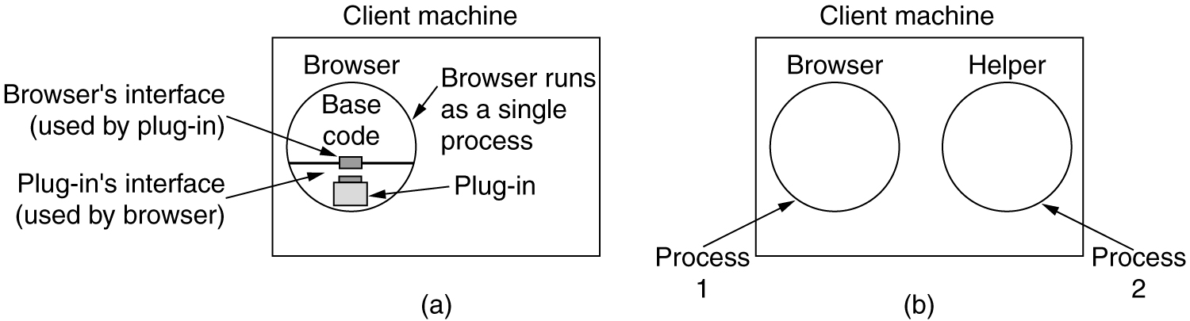
The Client Side
(a) A browser plug-in. (b) A helper application.

Slide 65
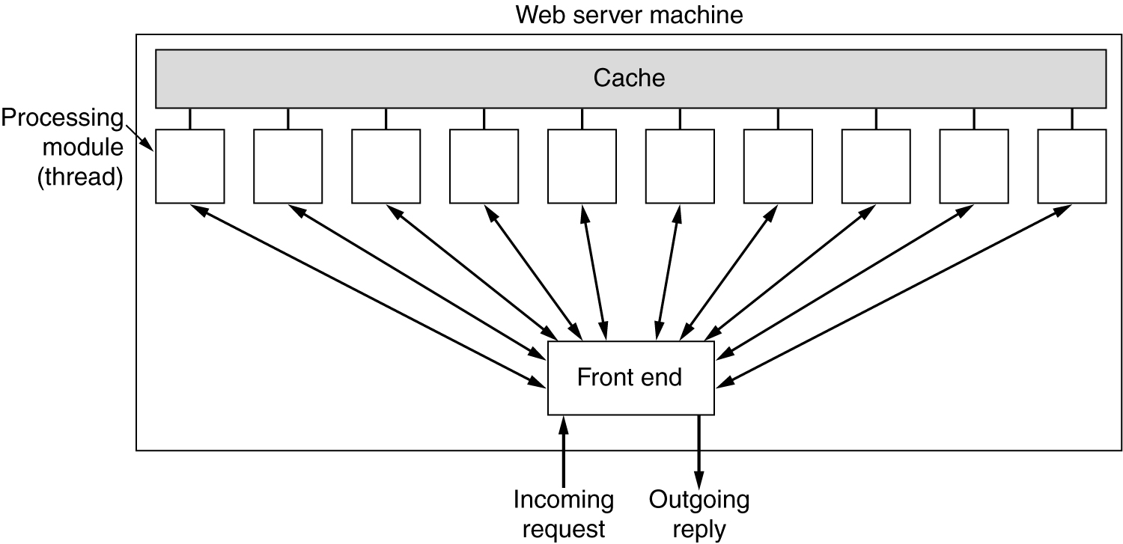
The Server Side
A multithreaded Web server with a front end and processing modules.

Slide 66
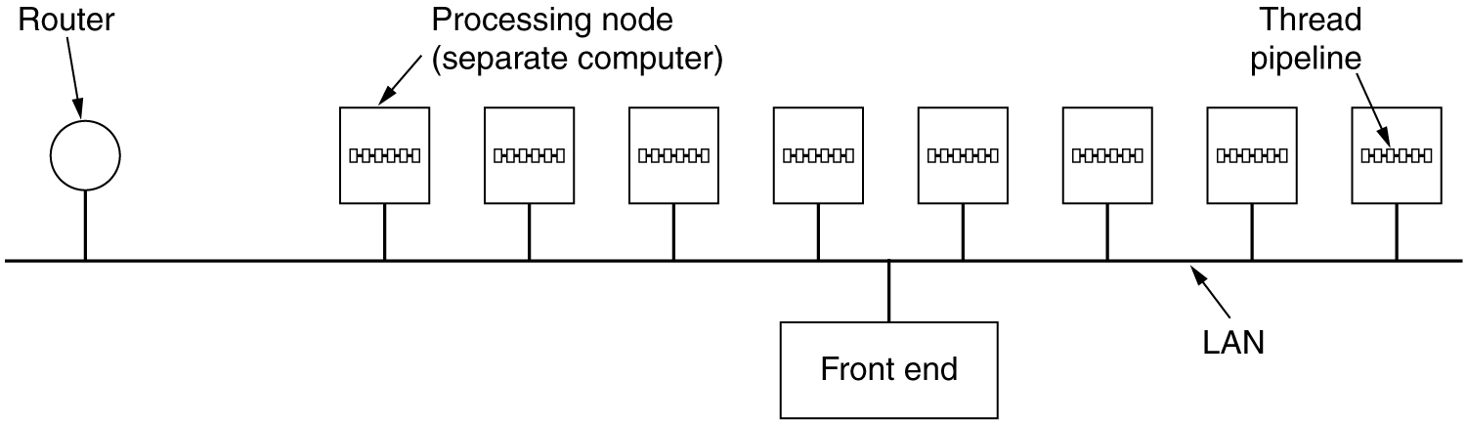
The Server Side (2)
A server farm.

Slide 67
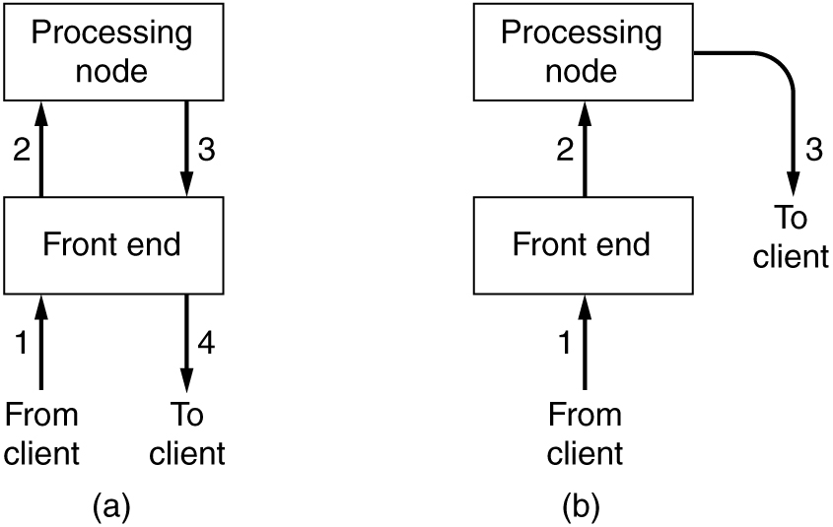
The Server Side (3)
(a) Normal request-reply message sequence.
(b) Sequence when TCP handoff is used.

Slide 68
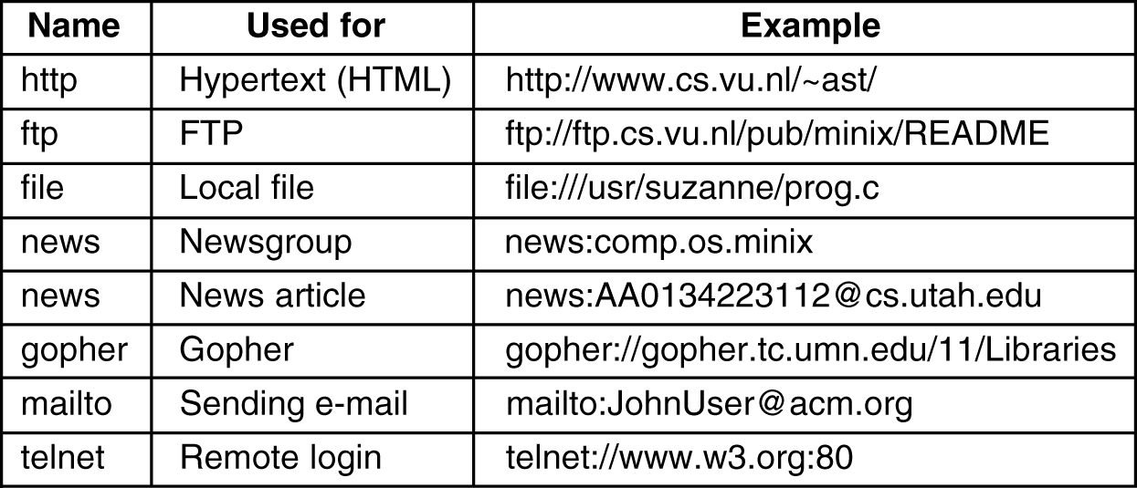
URLs – Uniform Resource Locaters
Some common URLs.

